Slide 1
ROAD TO ES
How to approach Event Sourcing and (mostly) survive

Slide 2

Where it all started
Defined by Fowler in 2005
“The fundamental idea of Event Sourcing is that of ensuring every change to the state of an application is captured in an event object, and that these event objects are themselves stored in the sequence they were applied for the same lifetime as the application state itself.”

Slide 3
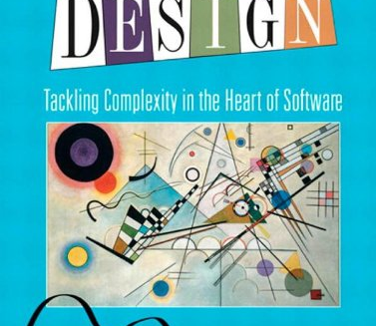
The basic ideas
DDD: Increases the Domain concept to Write and Read Models
Actors Model:
Every Domain has its own independant storage
The Domain state is changeable and visible by the external environment only through Messages
Microservices: The Read and Write models are isolated services

Slide 4

10K Feet View
Event Store
Event
API
Command Handler
Command
Write Side
Event
Read Side
Event Handler
Read Model
Data
Query Engine

Slide 5
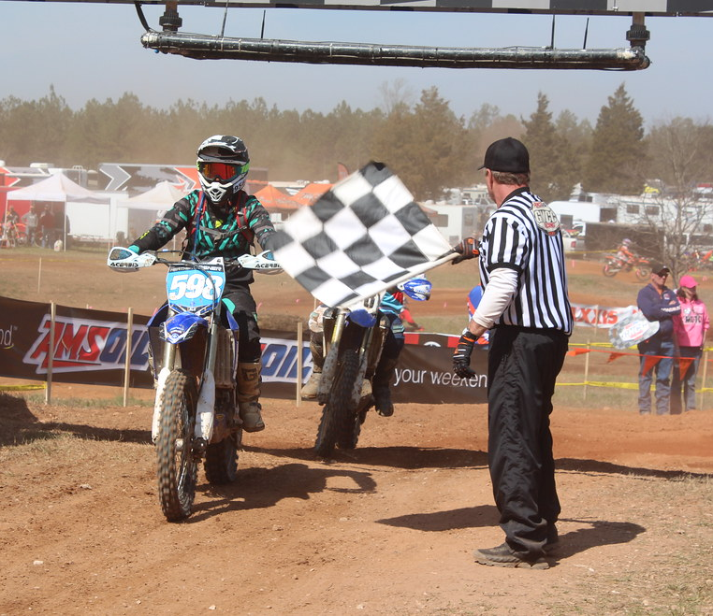
Let s’start

Slide 6
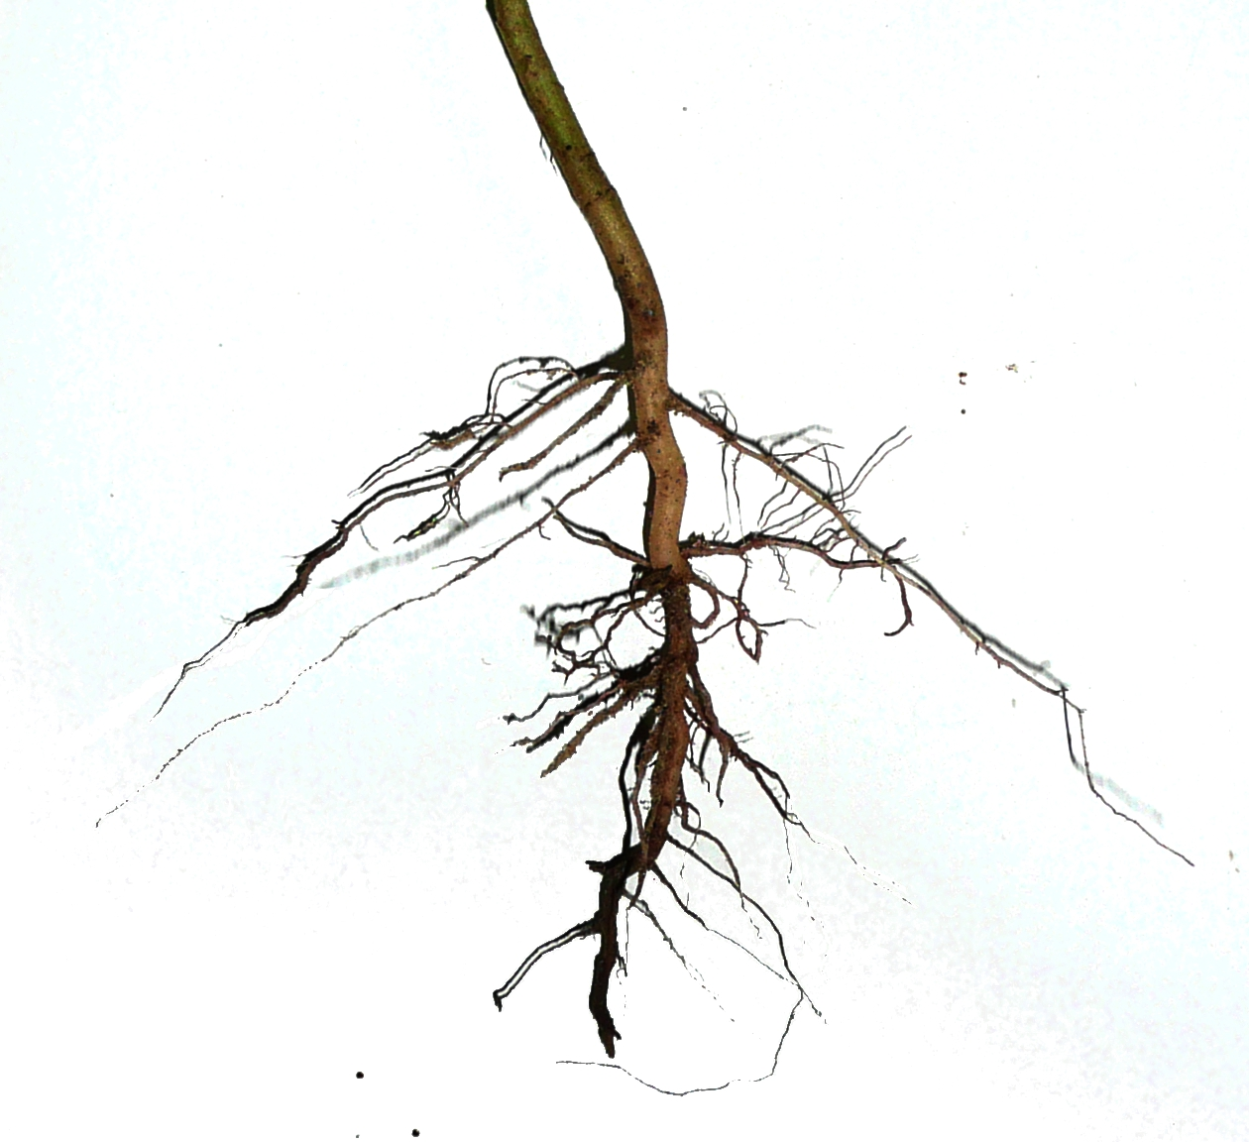
T01: The Aggregate Root
Is the main Business Entity
Given Command Methods produces Events
Contains all the data needed by the Business Logic
The name comes from the DDD terminology
Exposes Command Methods, that generate Events
Contains the state that will be written on the Write Model

Slide 7

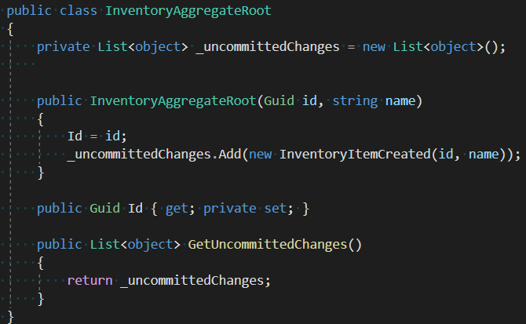
T01: The Aggregate Root

Slide 8

T01: Events
They are notifications of what is happened on the Write Model
Expressed in Past Tense “Cruise Created”
They cannot change the state of the Write Model
Contains all data changed by the Write Model
They can be spread through a Bus with Topics

Slide 9
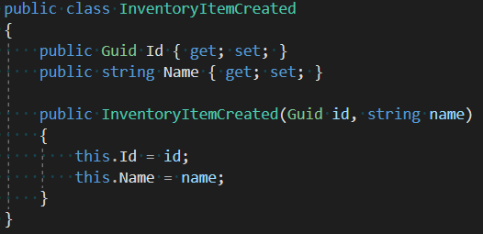
T01: Events

Slide 10
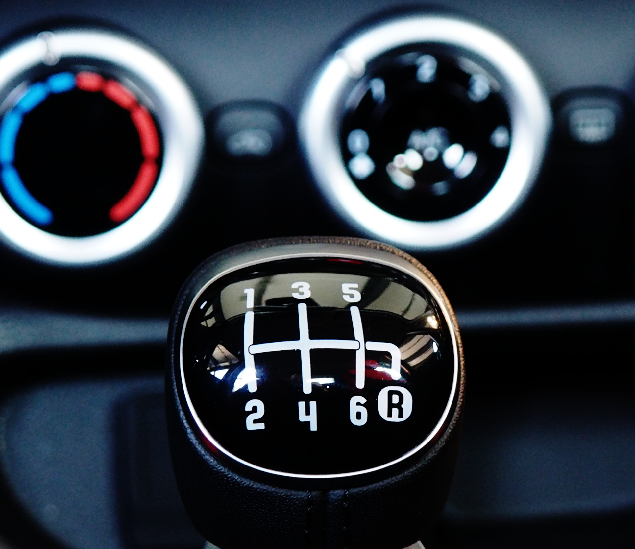
T01: The Command
Expressed in imperative like “Create Cruise”
Contains all the data needed to execute a request applied to the existing write model
To ease the implementation should be Idempotent: can be applied multiple time producing the same result

Slide 11
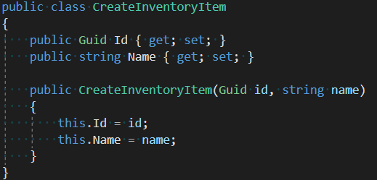
T01: The Command

Slide 12
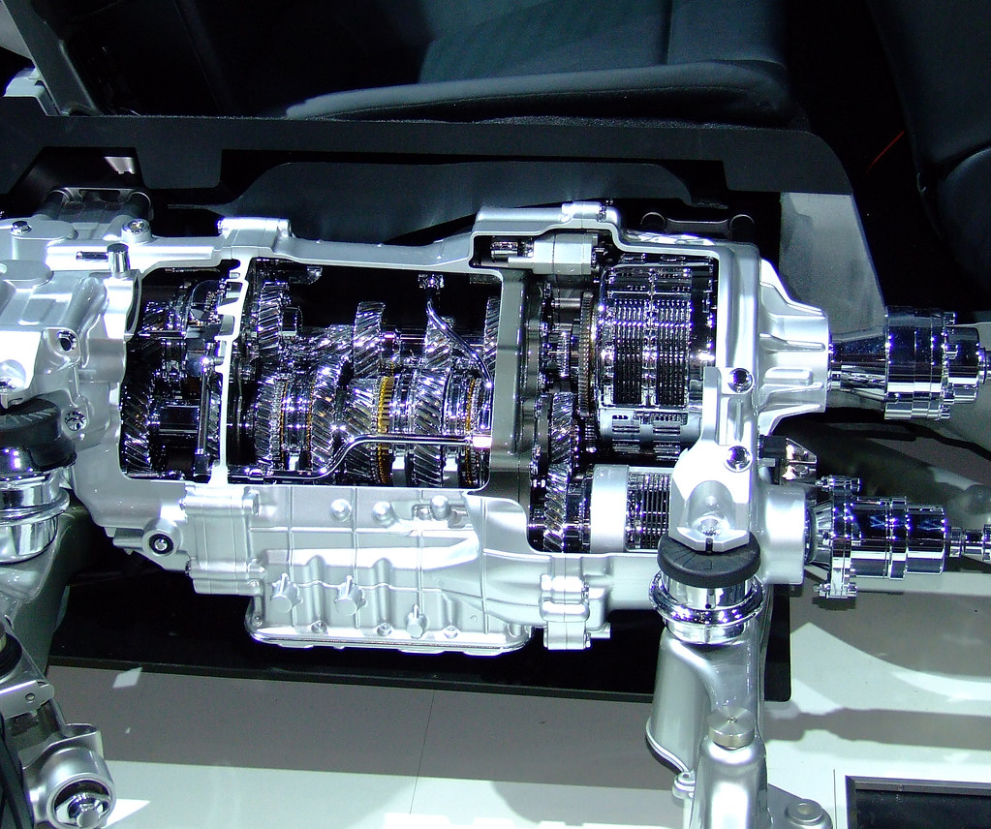
T02: The Command Handler
Receive the requests from in form of Command objects
Is the only entry point to access the Aggregate Root
Is responsible for all infrastructure-related deeds
Prepare the additional data for the Command Methods that he invokes
Mostly equivalent to the MVC controller
In this first step will store the events

Slide 13
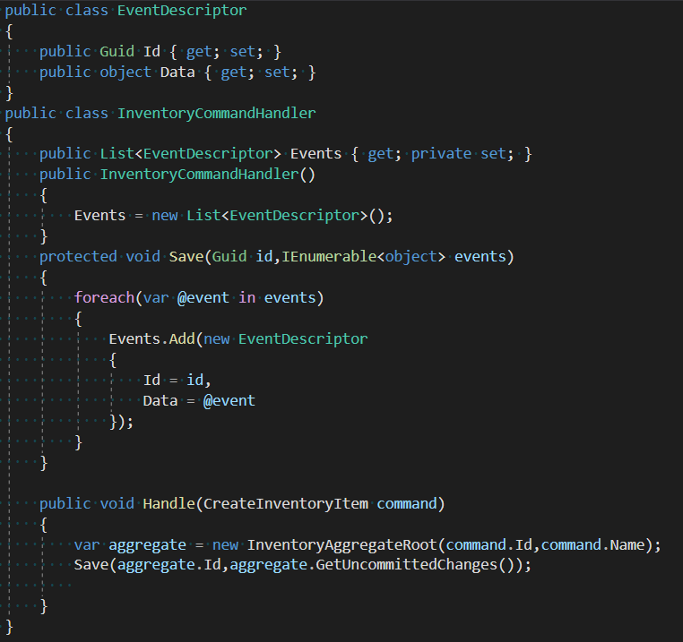
T02: The Command Handler

Slide 14

T03: Event Store
Will take the responsibility to save the stream of events
Now will be moved outside of the Command Handler following the SRP (Single Responsibility Principle)
Store the events in T-ple {id, version, type, serialized event}

Slide 15
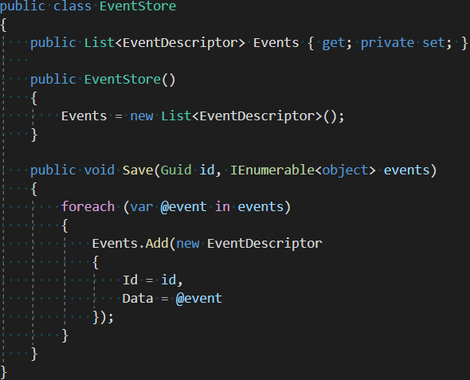
T02: The Command Handler

Slide 16
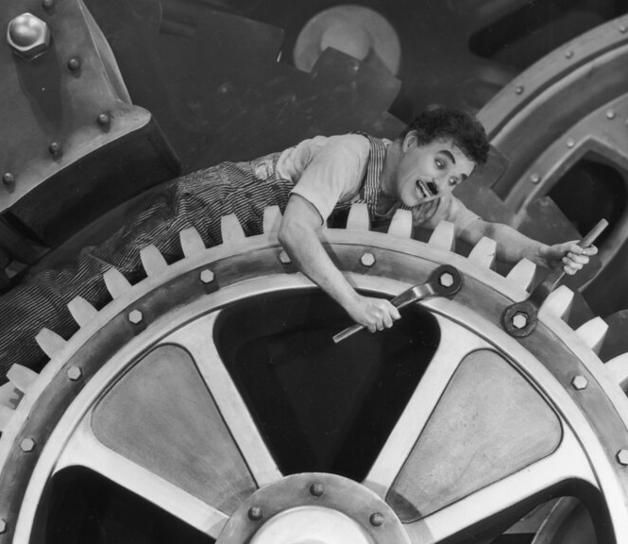
T04: Modify the aggregate
New Commands and Events will be added
The aggregate will have more methods exposed and will produce events for them
Once the events are saved the state should be reloaded via the Aggregate LoadFromHistory

Slide 17
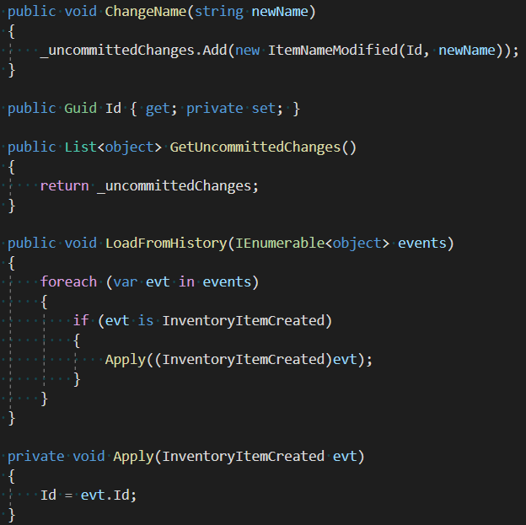
T04: Modify the aggregate

Slide 18
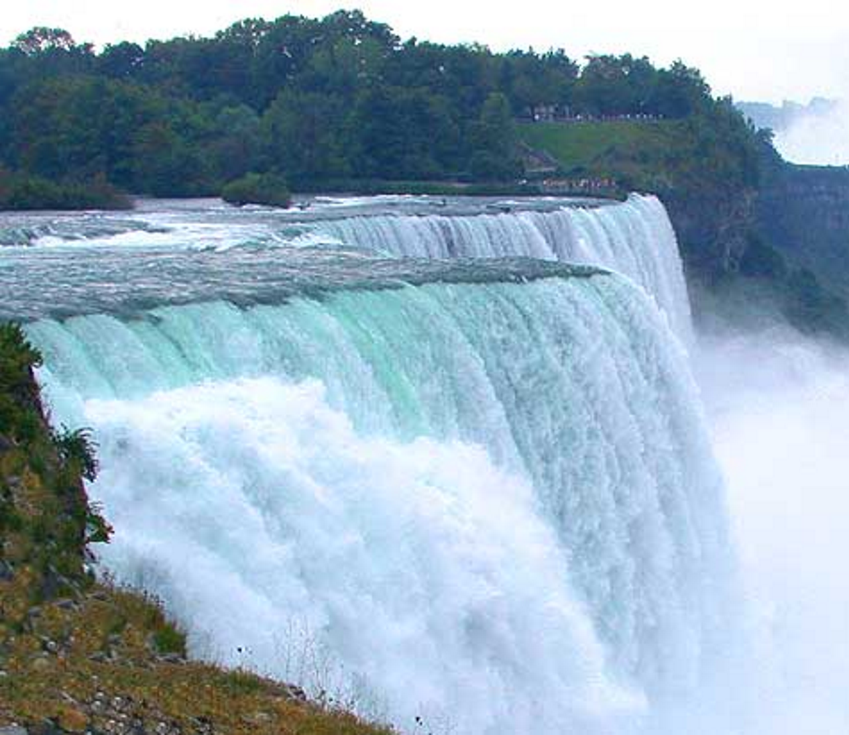
T05: Rehydration
When loading from the list of events ALL of them must be applied
The Aggregate should then handle all the event types that changes the state
Note that, until now, only the Id is a state variable. Only the create event is handled

Slide 19
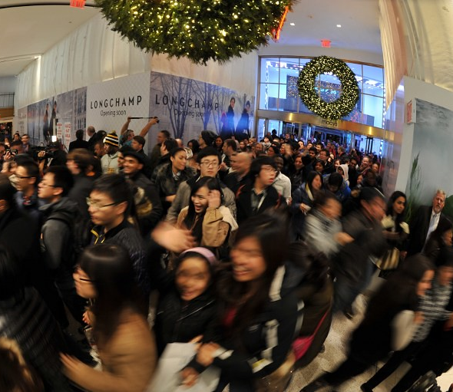
T05: Optimistic locking
Multiple users can send commands to the same Aggregate Root
This can be handled versioning the AR and send with the Commands the version of the AR used to prepare the command
The Entity Storage will add a Version field
When the expected version matches the storage one item is update and the operation is successful
Else an exception is thrown

Slide 20
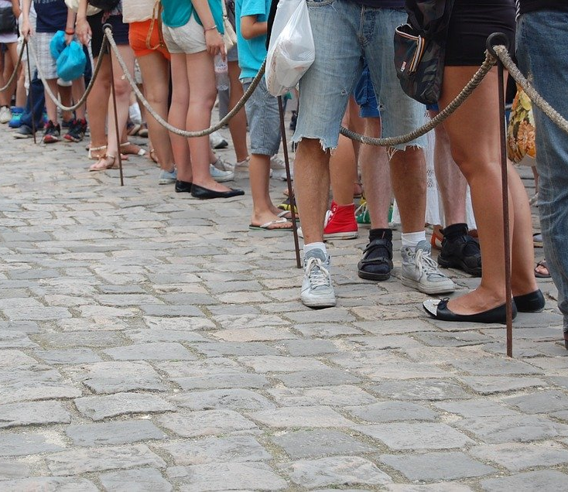
T05: Optimistic locking-Advantages
No need for “real” transactions (and therefore locks)
Works atomically
Usable even on NoSQL database
Easy to implement

Slide 21
T05: Optimistic locking
Database
Application
Version: 1
Retrieve
Version: 1
Update
Compare Versions
Save
Change to Version 2
Update with Version 1
Matching
Not Matching
Version: 2
Error

Slide 22

T03: Bus
We introduce the concept of Bus to
Send event to “external” systems and
Send command to Command Handlers
Should handle (at minimum)
Topics
Queues (if commands are not idempotent)

Slide 23
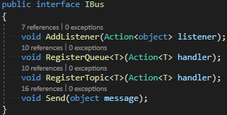
T03: Bus

Slide 24

T04: Read (Query) Model
Ideally there is one Read Model for each type query
Represents the data in the form easiest to search with
It's like a “Materialized View”
Usually is a flat table that can be interrogated via simple SELECT (or Projections in NoSQL language)

Slide 25
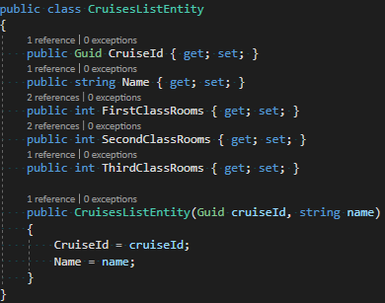
T04: Read (Query) Model

Slide 26
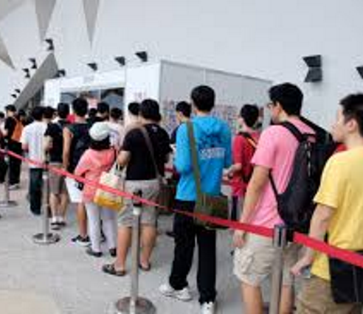
T04: Event Handlers
They build the Read Model
The receive events and create a view on data
Are similar to Data Warehouse system but in “Real-Time”
They can access external services to enrich the information received

Slide 27
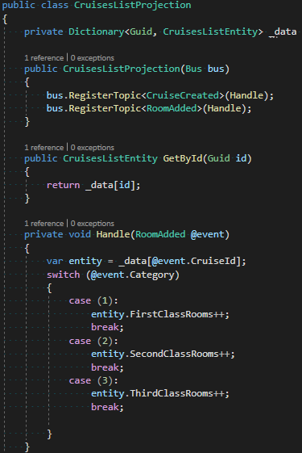
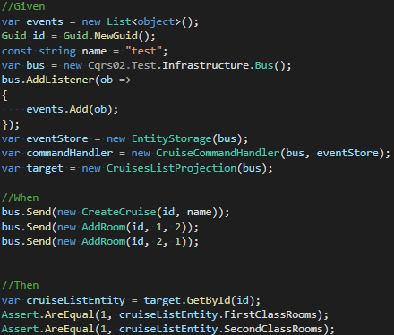
T04: Event Handlers

Slide 28

T04: The Projections
Exposes the content of the Read Model
They can be “merged” with the Event Handlers
Projections and Event Handlers should be the easiest part to write
Perfect to be left to Juniors or external teams

Slide 29
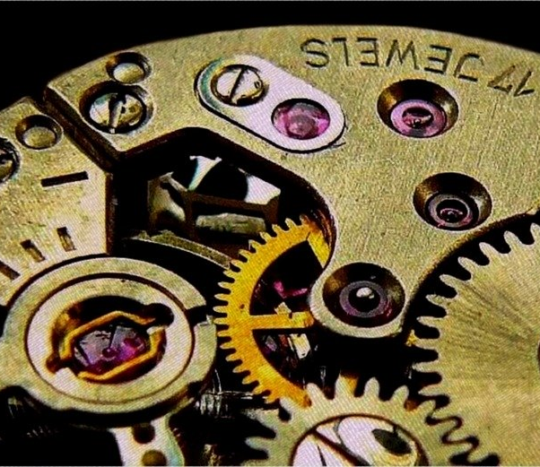
The Mythical Real-Time Db
Real-time make sense only within a defined timespan
Real time in railway systems is “in less than 350ms”
The usage of bus introduce a delay between the application of the command and the availability of the data: This is the Eventual Consistency
The same happens when locking a table for a transaction

Slide 30

Expanding the view

Slide 31
T04: Event Handlers

Slide 32
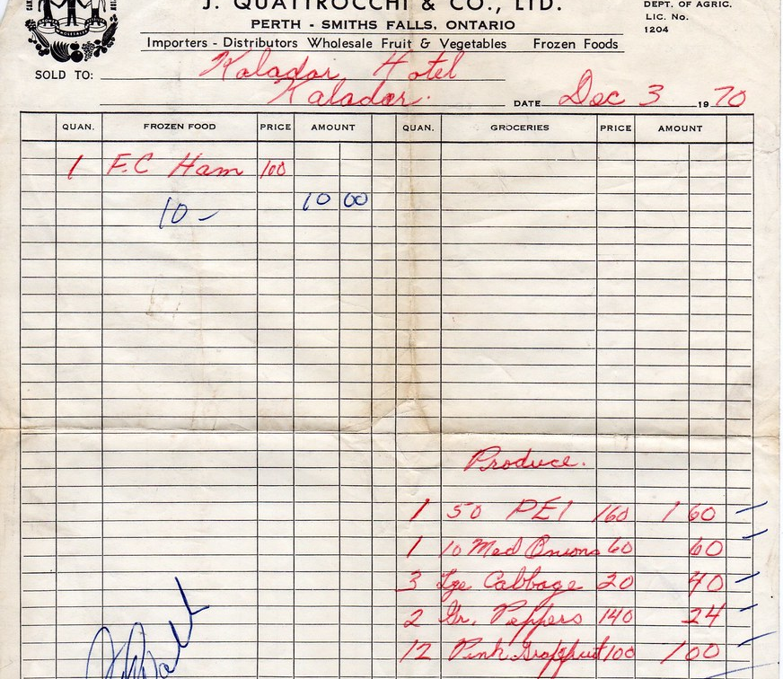
The Invoices and Customer Domains
Should create Invoices associated with Customers
When Emitting an Invoice should store the Billing Address, that could not be changed
Invoices and Customers are separated Domains

Slide 33
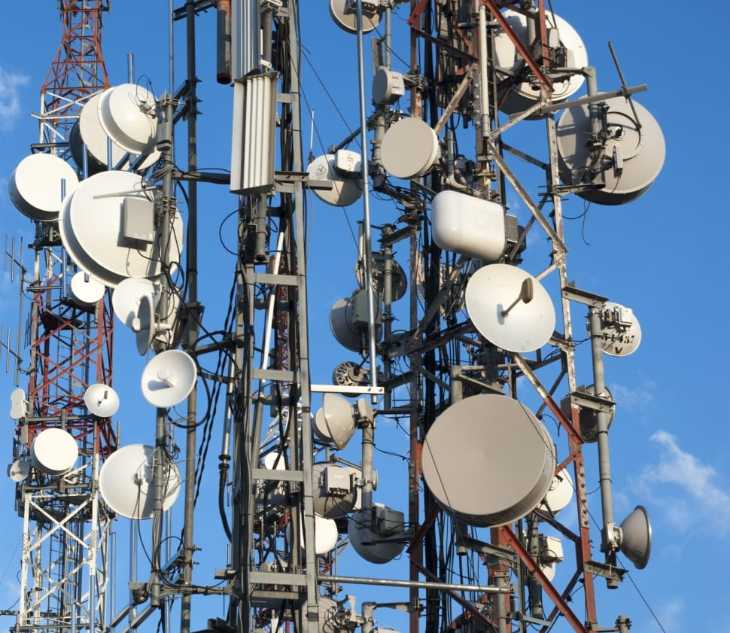
T06: Referencing External Domains
All external Aggregate Roots (or Crud items) must be referenced by Id
The Event Handlers can retrieve the linked items data and store it to reduce the Query complexity
The Command Handlers will access the proxied services exposed by the other domains

Slide 34
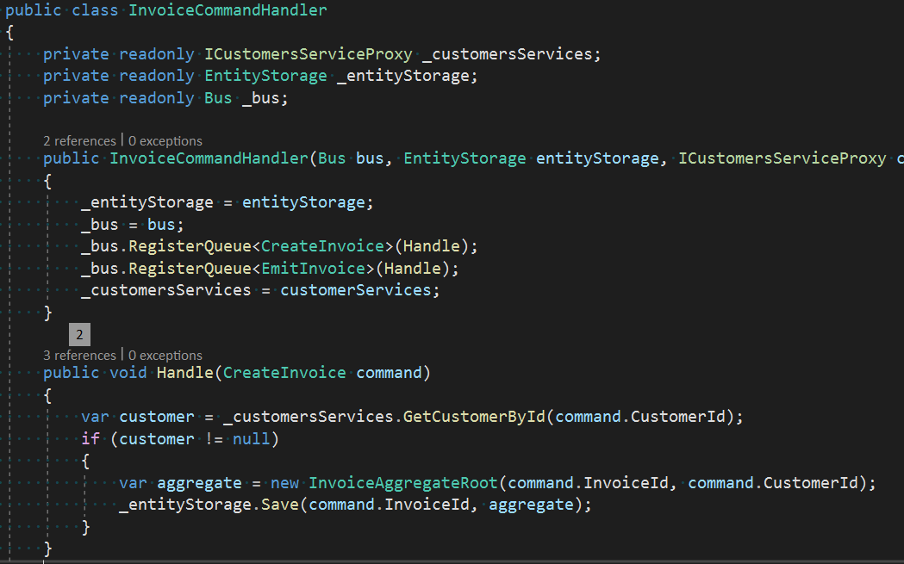
T06: Referencing External Domains

Slide 35
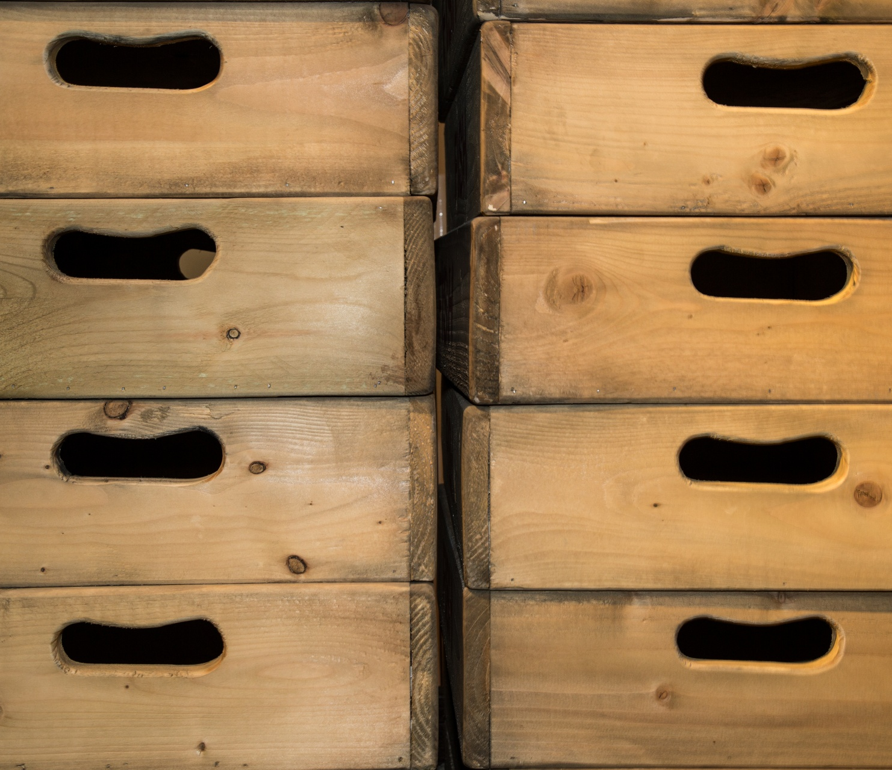
T07: Value Objects
To store “invariants” like and Address will be used the Value Object concept
A Value Object is an Object whose Natural Key is the whole object: does not break the rule of referring to external items via Id only

Slide 36
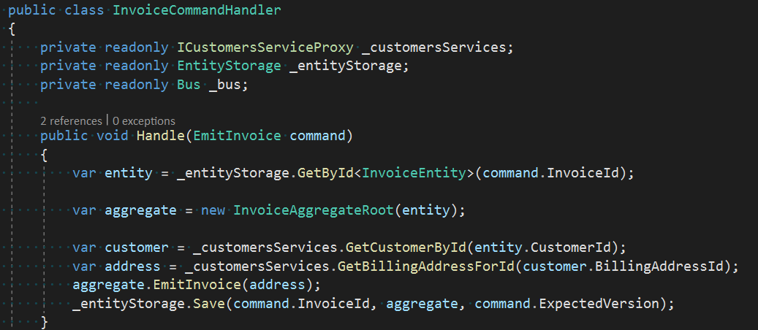
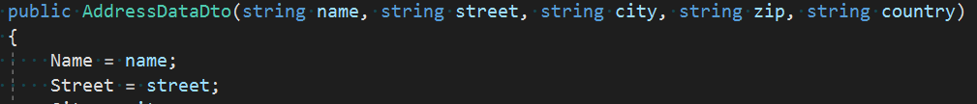
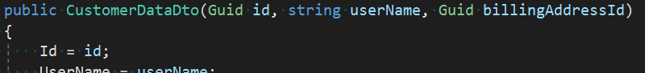
T06: Referencing External Domains

Slide 37
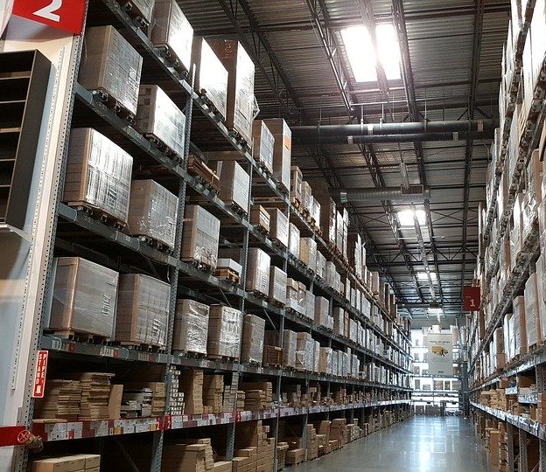
Warehouse and Payments
Identify the Domain of Warehouse allowing to Reserve Items
Another Domain will be Payment, or the Payment Process
When a Payment is started a request is issued to Reserve Items
Contextually a delayed Expire event is issued

Slide 38
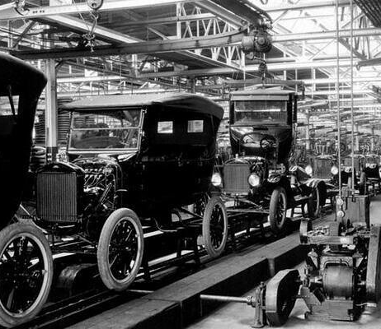
T08: Local Distributed Transactions
The idea is to use timeouts to cancel transactions. Like the 2PC
The Warehouse Domain handles the Expiration of Reservation by itself (probably sending delayed Expiration messages)
The Payment Domain, when creating a Payment send a Delayed Expiration message
If the Expiration arrives with the Payment still reserving the Payment is canceled
Orchestration driven by Payment

Slide 39
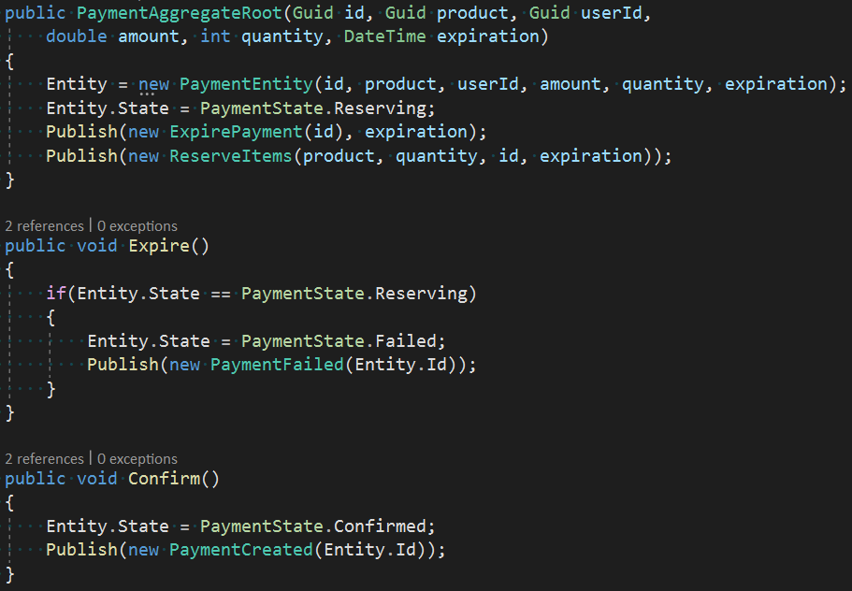
T08: Local Distributed Transactions

Slide 40
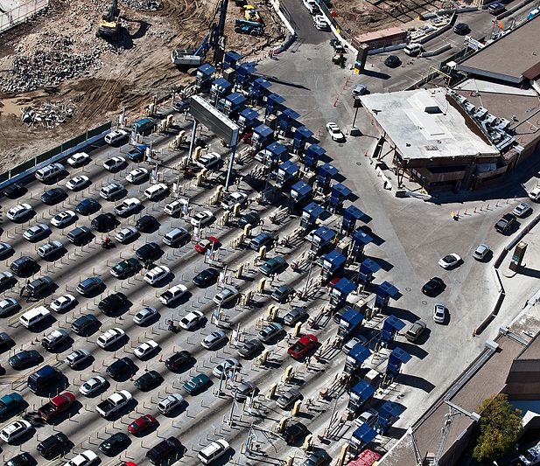
Crossing Boundaries
The Payment domain is extended with a connection with PayPal
The PayPal service is exposed via a Proxy
When Reservation or PayPal Payment fails the Payment is canceled
When the Payment Expire the PayPal Payment is canceled

Slide 41

T09: Worldwide Distributed Transactions
The PayPal Proxy service is called inside the Command Handler to hide its data from the Aggregate
The PayPal Proxy service will send a message when the payment fails or succeed
When the Payment expire and no answer exists from PayPal the system tries to cancel the payment compulsively

Slide 42
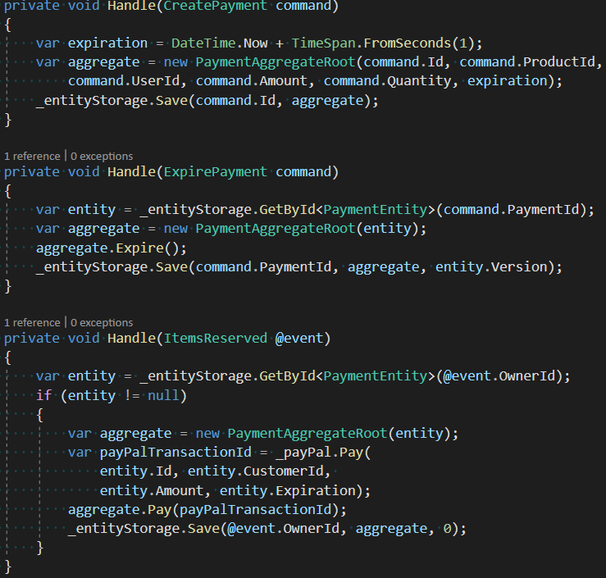
T09: Worldwide Distributed Transactions

Slide 43
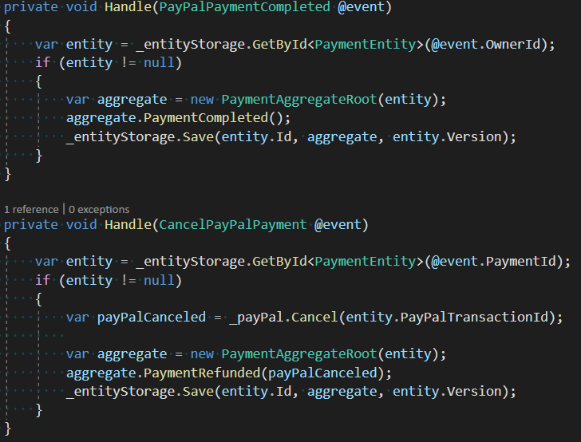
T09: Worldwide Distributed Transactions

Slide 44
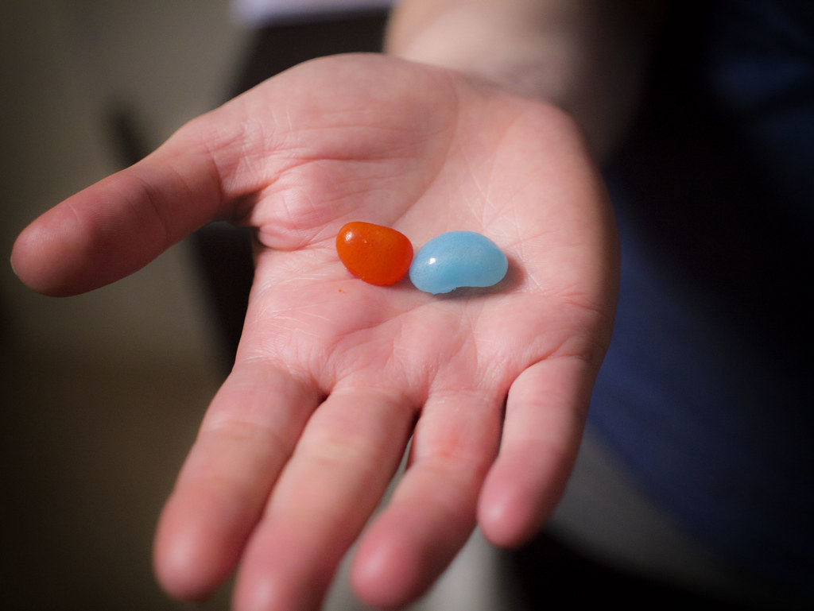
The Red Pill

Slide 45
What is missing
What we have seen until now is only a toy implementation. Several issues should be addressed e.g. (but not limited to):
Bus failures: in these examples we assume the bus never fails. We should use a subsystem that handles these situations, like a retry policy to send the Events
Messages not sent after the update (may be we should first send messages then save the data)
The distributed transactions or better “sagas” would be handled easily with a State Machine. Some Service Bus implementation offers even specific DSLs to ease the solution.
The “toxic” messages will be sent typically on the “Dead Letter” queues. Someone should take care of them!
Use only when fitting: an example would be a Tree data structure. Sometimes the effort to build a Domain is simply too big

Slide 46
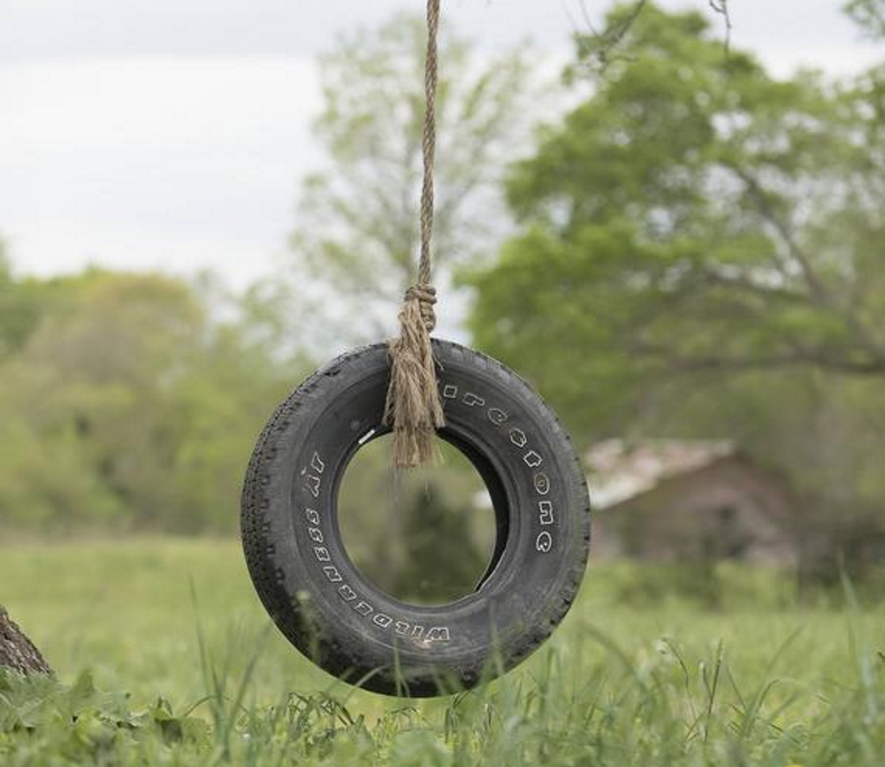
Simplest possible thing
An example from Greg Young of a simple CQRS system to handle a Warehouse, stubs based
Extended with
RabbitMQ
MongoDB
AngularJS
The new implementation can show a reliable template for a real CQRS application

Slide 47

Thank You!

Slide 48
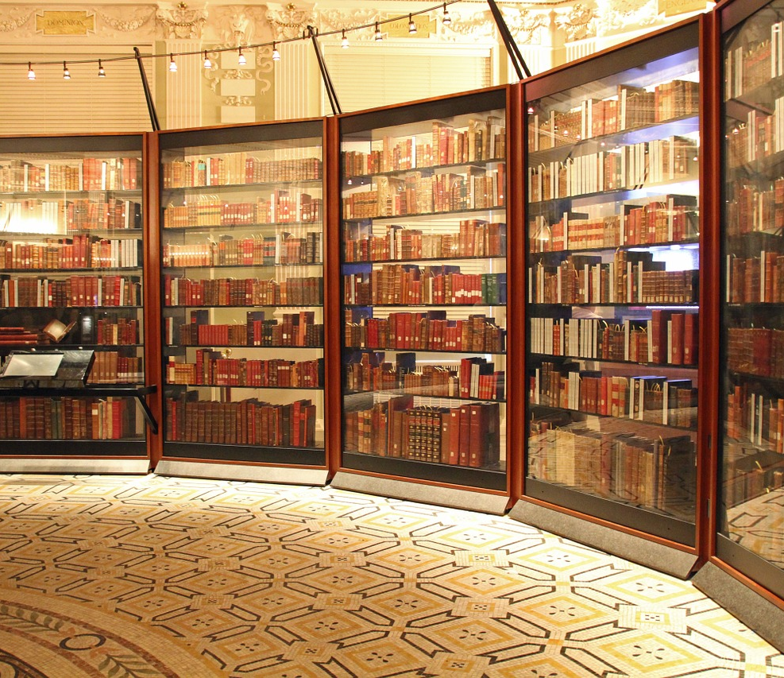
References
Eric Evans, Domain-Driven Design, Addison-Wesley, 2003
Jimmy Nilsson, Applying Domain-Driven Design and Patterns, Pearson, 2006
Vaughn Vernon, Implementing Domain Driven Design, Pearson, 2013
Greg Young’s Simplest Possible Thing (C#), https://github.com/gregoryyoung/m-r
Martin Fowler, https://martinfowler.com
Jimmy Bogard, https://jimmybogard.com

Slide 49
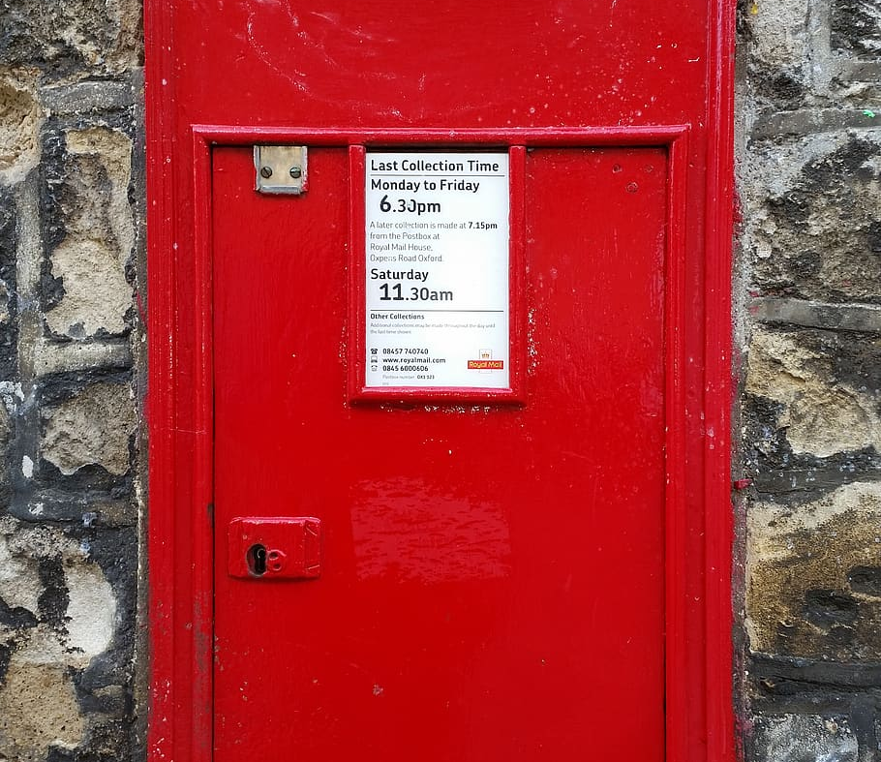
Contacts
Github: https://github.com/kendarorg
Linkedin: https://linkedin.com/enricodaros
E-mail: edr@kendar.org

